Slide 1
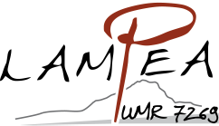
ICAZ 2018 - High-resolution analyses of dental remains: broadening horizons
Contribution of ecometric methods to describe local environments: the case of the Middle Pleistocene site of Lunel-Viel (Hérault, France)
Antigone Uzunidis
antigone.uzunidis@wanadoo.fr

Slide 2
Introduction – Material and methods - Data - Conclusions
≈ MIS 7
Hyenid den with evidence of Human incursions
Temperate Mediterranean climate
Species
Cervus elaphus | Lynx spelaea
Euctenoceros mediterraneus | Lynx cf. pardina
Capreolus cf. süssenbornensis | Felis lunellensis
Bison cf. schoetensacki | Felis monspessulana
Bos primigenius trochoceros | Ursus cf. deningeri
Sus sp. | Canis lupus lunellensis
Stephanorhinus hemitoechus | Cuon priscus
Equus mosbachensis palustris | Vulpes vulpes
Equus hydruntinus minor | Meles meles
Crocuta spelaea intermedia | Mustela palerminea
Hyaena prisca | Lutra sp.
Panthera (leo) spelaea

Slide 3
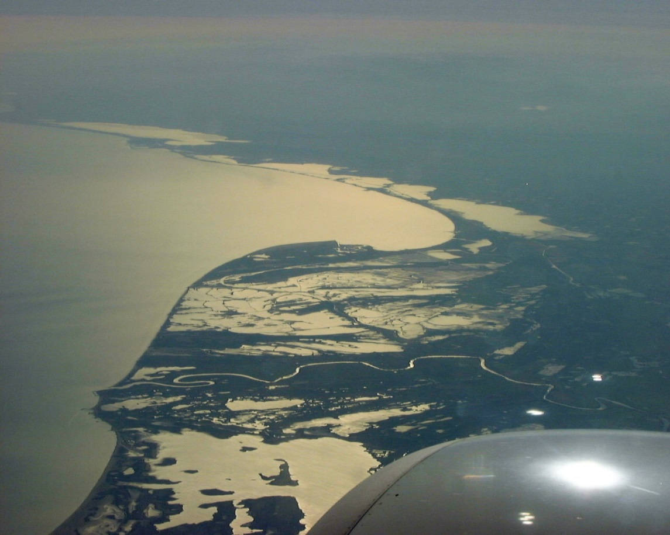
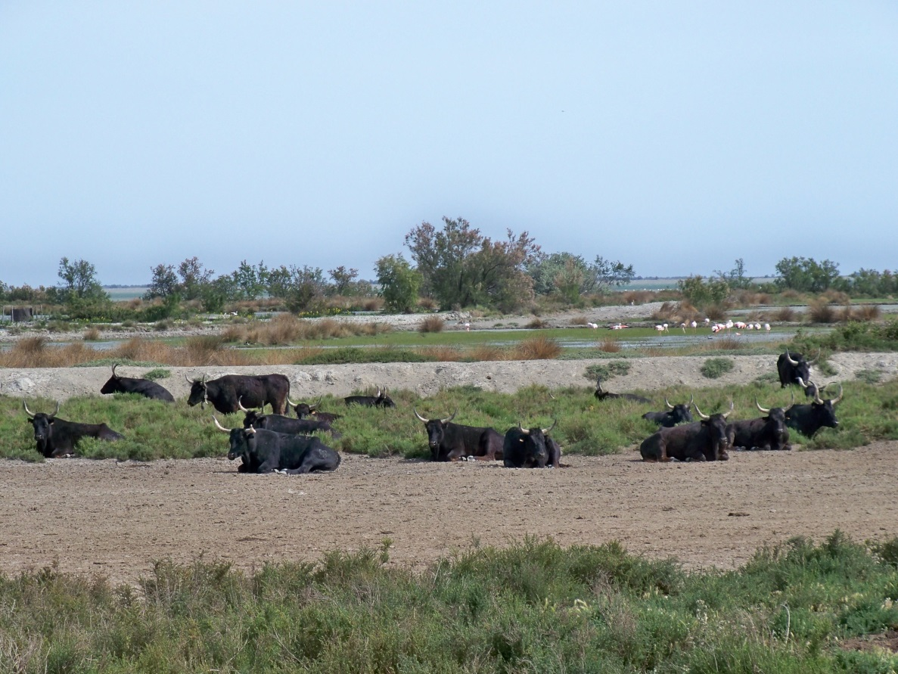
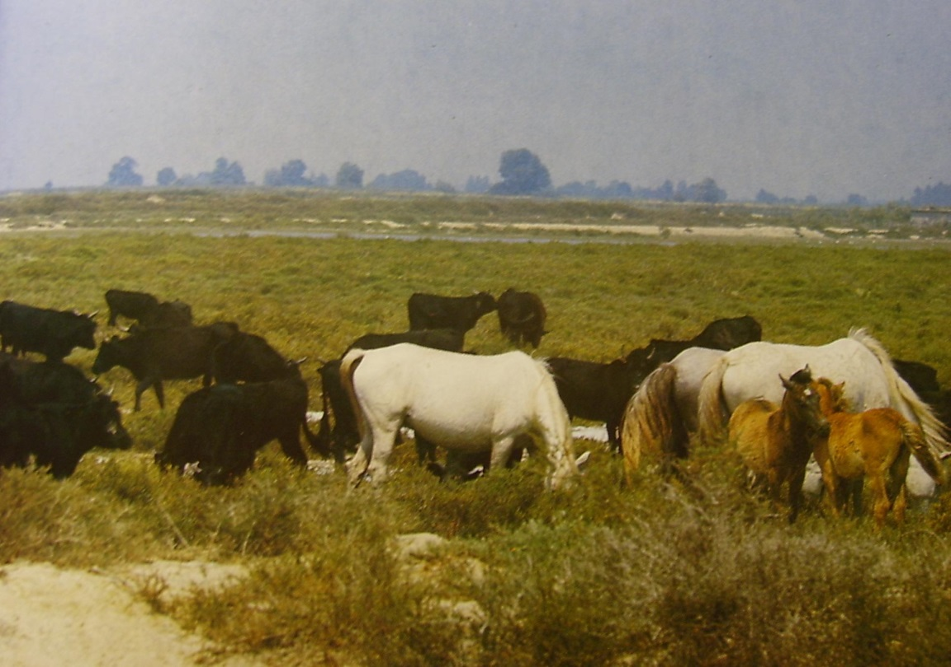
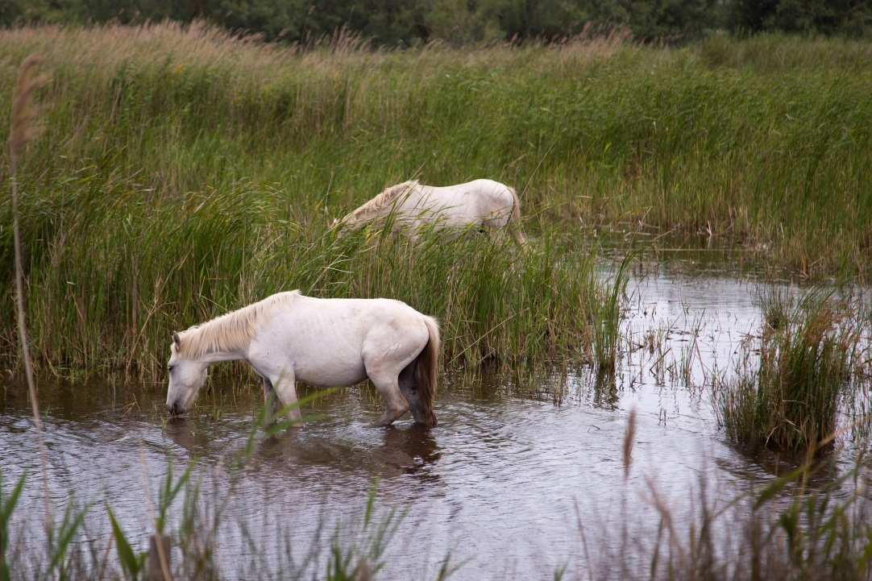
Introduction – Material and methods - Data - Conclusions

Slide 4
Introduction – Material and methods - Data - Conclusions
Very robust limb bones
Horse living in a swamp?
M.-F. Bonifay, 1980

Slide 5
Introduction – Material and methods - Data - Conclusions
Meso-wear analysis
Micro-wear analysis
Macroscopique analysis
Microscopique analysis
Diet of the last months
in the individual’s life.
Diet of the last days
in the individual’s life.

Slide 6
Introduction – Material and methods - Data - Conclusions
Collect of teeth from extant Equus and Bos at the Tour-du-Valat, Camargue
No artificial feeding
Meso-wear
Lunel-Viel |  |  | Tour-du-Valat
 | Equus | Bos |  | Equus | Bos
I inf | 21 | 62 | Spring/Summer |  | 9
I sup | 20 | 20 | Autumn/Winter |  | 1
IV | 9 |  | Unknown | 4
Total | 50 | 82 |  | 4 | 10
Micro-wear
Lunel-Viel |  |  | Tour-du-Valat
 | Equus | Bos |  | Equus | Bos
I inf | 14 | 7 | Spring/Summer |  | 10
I sup | 13 | 16 | Autumn/Winter |  | 6
IV | 8 |  | Unknown | 10
Total | 35 | 23 |  | 10 | 16

Slide 7
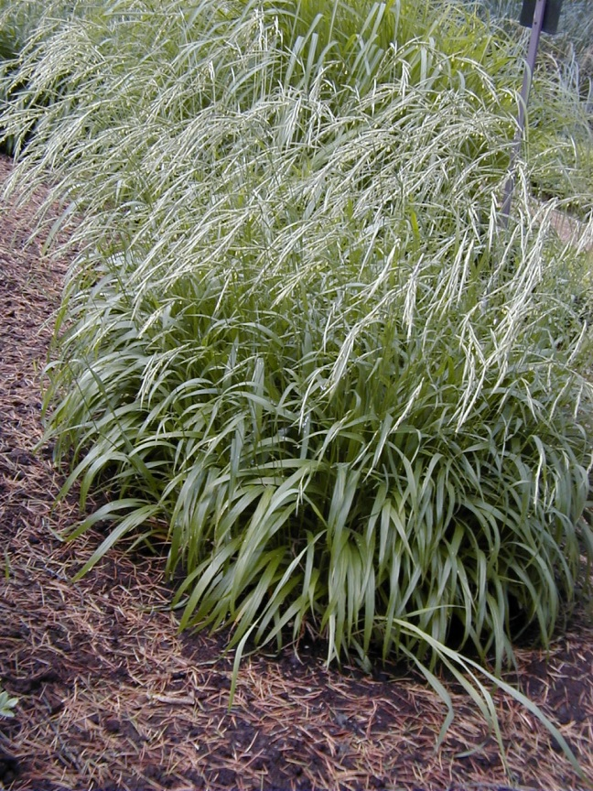
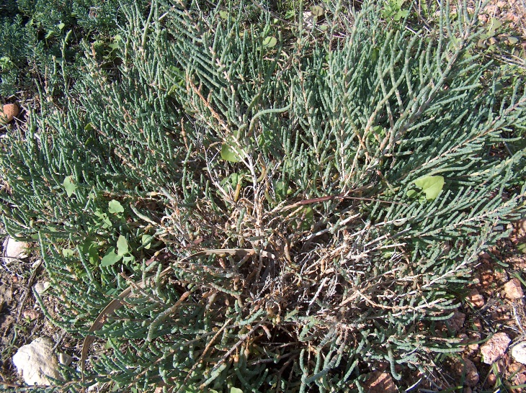
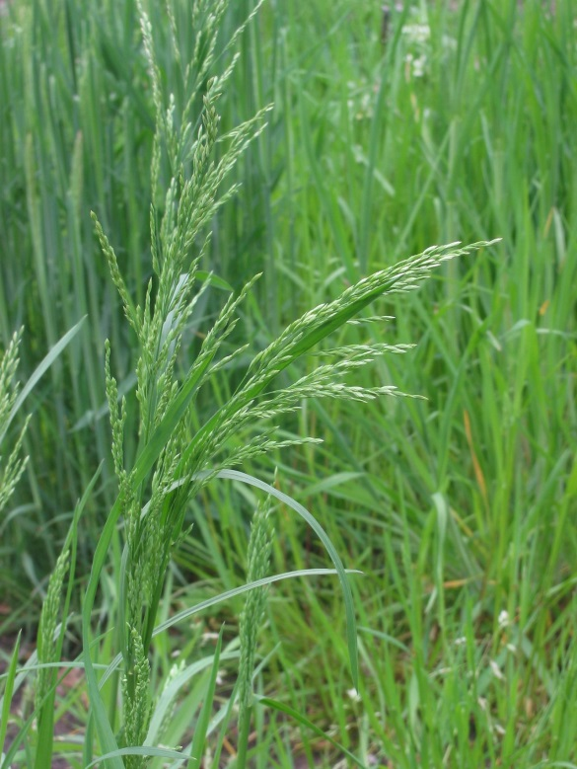
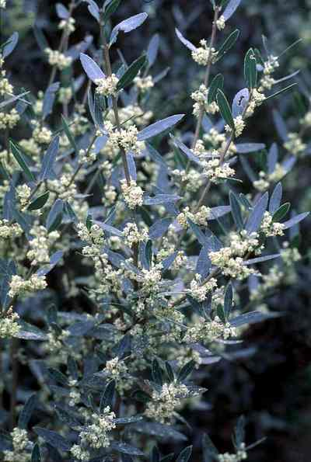
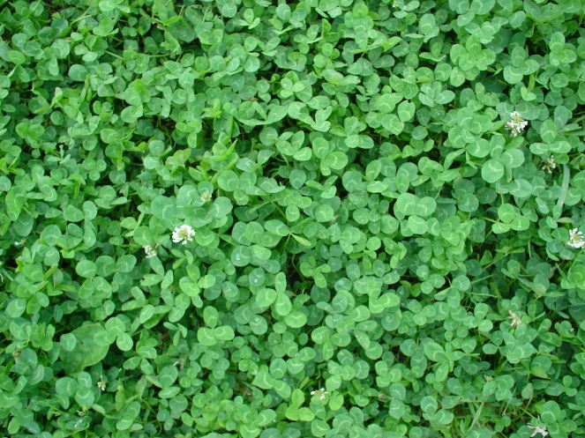
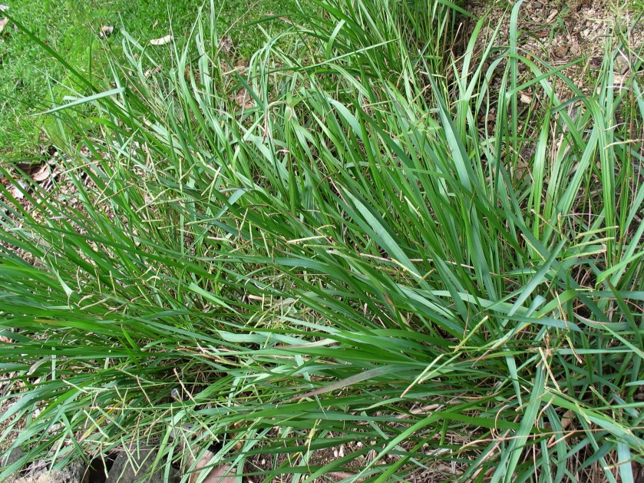
Introduction – Material and methods - Data - Conclusions
Very various landscapes and vegetal composition
6A Coarse grasslands with shrubs (Brachypodium phoenicoides, Agropyron pungens, Phillyrea angustifolia, etc.)
6B Halophyte grasslands (Halimione portulacoides, Limonium vulgare, Limonium bellidifolium , Medicago spp., Phillyrea angustifolia, etc.)
Monocotyledon
Some examples
Dicotyledon
OFG Old-field grasslands (Poa trivialis, Trifolium repens, Paspalum paspalodes, etc.)
5 Salt flats, with woody and herbaceous halophytes (Arthrocneum spp., Halimione portulacoides, Puccinellia distans, Juncus subulatus, etc.)
4 Lower salt flats (Arthrocneum glaucum with no herb layer)
OFM Old-field marshes, artificially flooded October–June (Paspalum paspalodes, Phragmites australis, Alisma plantago-aquatica, etc.)
Arthrocneum glaucum
2 Shallow marshes, flooded for 2–6 months, winter–spring (Polypogon maritimum, Halimione portulacoides, Alopecurus bulbosus, Aeluropus littoralis, Juncus gerardii, etc.)
1 Deep marshes, flooded 9–12 months, autumn–summer (Bolboschoenus maritimus, submerged macrophytes, and some Phragmites australis)
Brachypodium phoenicoides
Poa trivialis
Trifolium repens
Phillyrea angustifolia
Paspalum

Slide 8
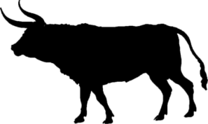
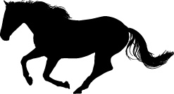
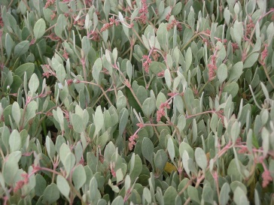
Introduction – Material and methods - Data - Conclusions
Observations on extant Bos and Equus from Camargue feeding habits
Autumn/Winter
Spring
Coarse grasslands
with shrubs
Old-field grasslands
Old-field marshes
Shallow marshes
Monocotyledon
Salt marshes plants
(Halimione portulacoides)
Summer
Principal difference:
Bos eat more dicotyledon plants than Equus.
(Phillyrea angustifolia in winter; clover in summer)
Monocotyledon
Data: Duncan, 1992; Duncan, 1993; Menard et al., 2002

Slide 9
Introduction – Material and methods - Data - Conclusions
Mesowear analysis

Slide 10
Introduction – Material and methods - Data - Conclusions
Microwear analysis

Slide 11
Introduction – Material and methods - Data - Conclusions
Microwear analysis

Slide 12
Introduction – Material and methods - Data - Conclusions
Microwear analysis
Taxon and localisation | Pits | Scratches
Equus : Tour du Valat _ Bos : Tour du Valat | 0,50 | 0,45
Bos : Tour du Valat _ Equus : Lunel-Viel | <0,0001 | 1,00
Bos : Tour du Valat _ Bos : Lunel-Viel | <0,0001 | <0,0001
Equus : Tour du Valat _ Equus : Lunel-Viel | <0,0001 | 0,21
Equus : Tour du Valat _ Bos : Lunel-Viel | <0,0001 | <0,0001
Equus : Lunel-Viel _ Bos : Lunel-Viel | <0,0001 | <0,0001

Slide 13
Introduction – Material and methods - Data - Conclusions
Microwear analysis

Slide 14
Introduction – Material and methods - Data - Conclusions
Microwear analysis
Tour-du-Valat
Equus
Lunel-Viel
Equus
Specific taphonomic impact?
- Tour-du-Valat: 50% of altered teeth (no observation possible)
- Lunel-Viel: 20% of altered teeth (no observation possible)
In relation with the presence of salt in the swamp ?

Slide 15
Introduction – Material and methods - Data - Conclusions
Tour-du-Valat
Mesowear analysis : Equus and Bos mixed-feeder
Microwear analysis : high number of pits
Equus grazer
Bos mixed-feeder to grazer
Meso-and Microwear : important overlap in Bos and Equus foraging behaviour
Important taphonomic alterations
Lunel-Viel
Mesowear analysis : Equus grazer
Bos browser
Microwear analysis : low number of pits
Equus grazer
Bos browser
Meso-and Microwear : important segregation in Bos and Equus foraging behaviour
Low taphonomic impact
Horse/bovid diet at Lunel-Viel ≠ Horse/bovid diet in Camargue
Local environment at Lunel-Viel ≠ Swamp

Slide 16
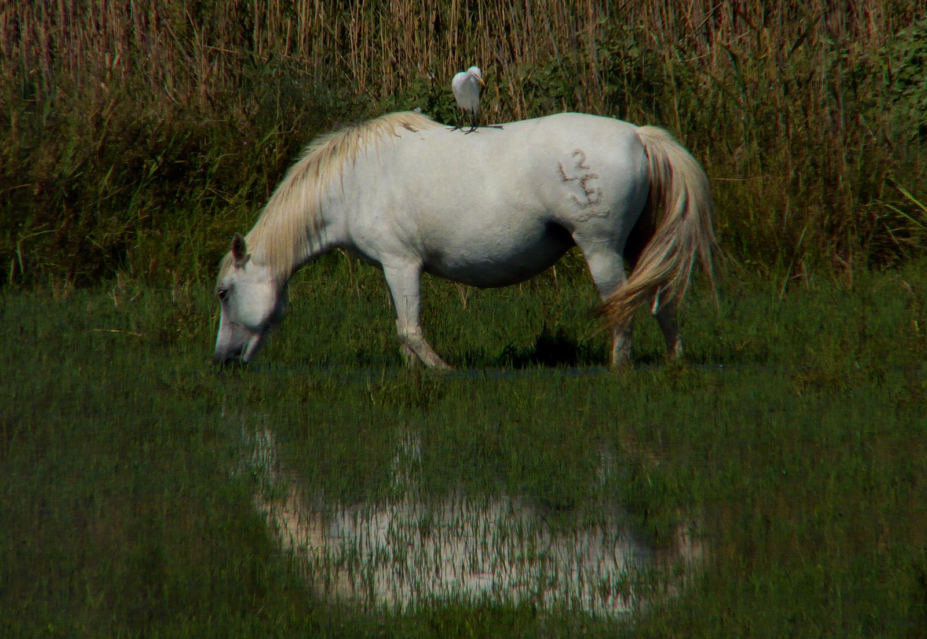
Thanks a lot for your attention
antigone.uzunidis@wanadoo.fr

