Slide 1
Determination of the death season by dental cementum analysis of horses Equus ferus (Boddaert, 1785) from the Upper Paleolithic site Kostenki 14 (Markina gora) (Voronezh region, Russia)
N.E. Prilepskaya¹, N.D. Burova², A.A. Sinitsyn²
¹ Lomonosov Moscow State University (Moscow, Russia)
e-mail: nprilepskaya@gmail.com
² The Institute of the History of Material Culture of RAS (Saint Petersburg, Russia)
Ancara 2018

Slide 2
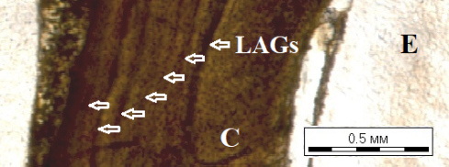
Growth layers in dental cementum of Equus ferus tooth (M1) from layer IVa of the paleolithic site Kostenki-14 (Markina gora).
Sample #K-14-IVа-1998/Π69/20p.
LAG - line of arrested growth; C – cementum; E – enamel.

Slide 3
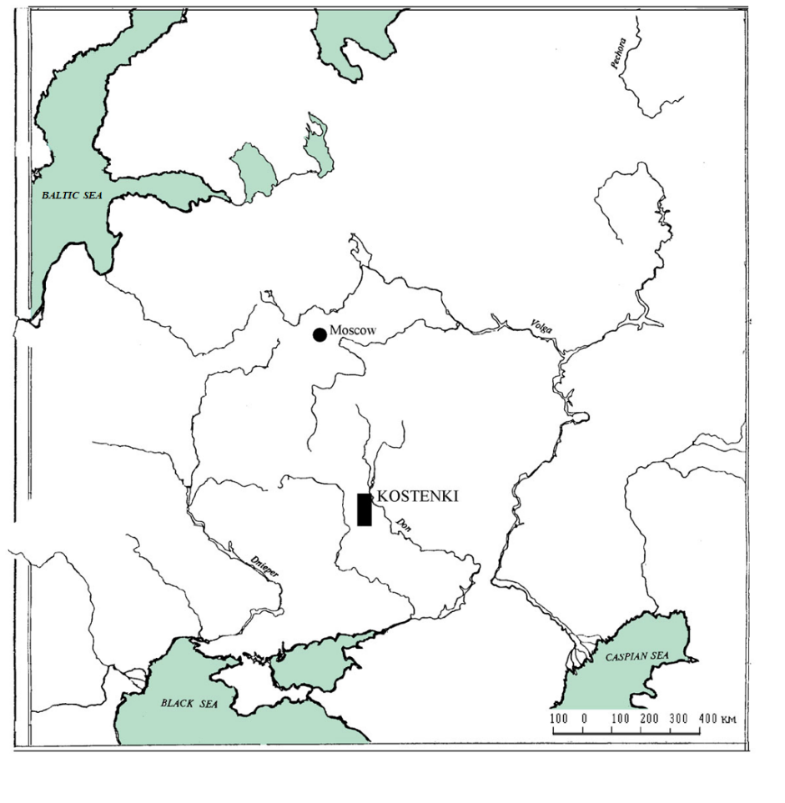
Geographical location of Kostenki village

Slide 4
Location of Kostenki 14 (Markina Mountain) site among the paleolithic sites of Kostenki-Borshchevo district

Slide 5
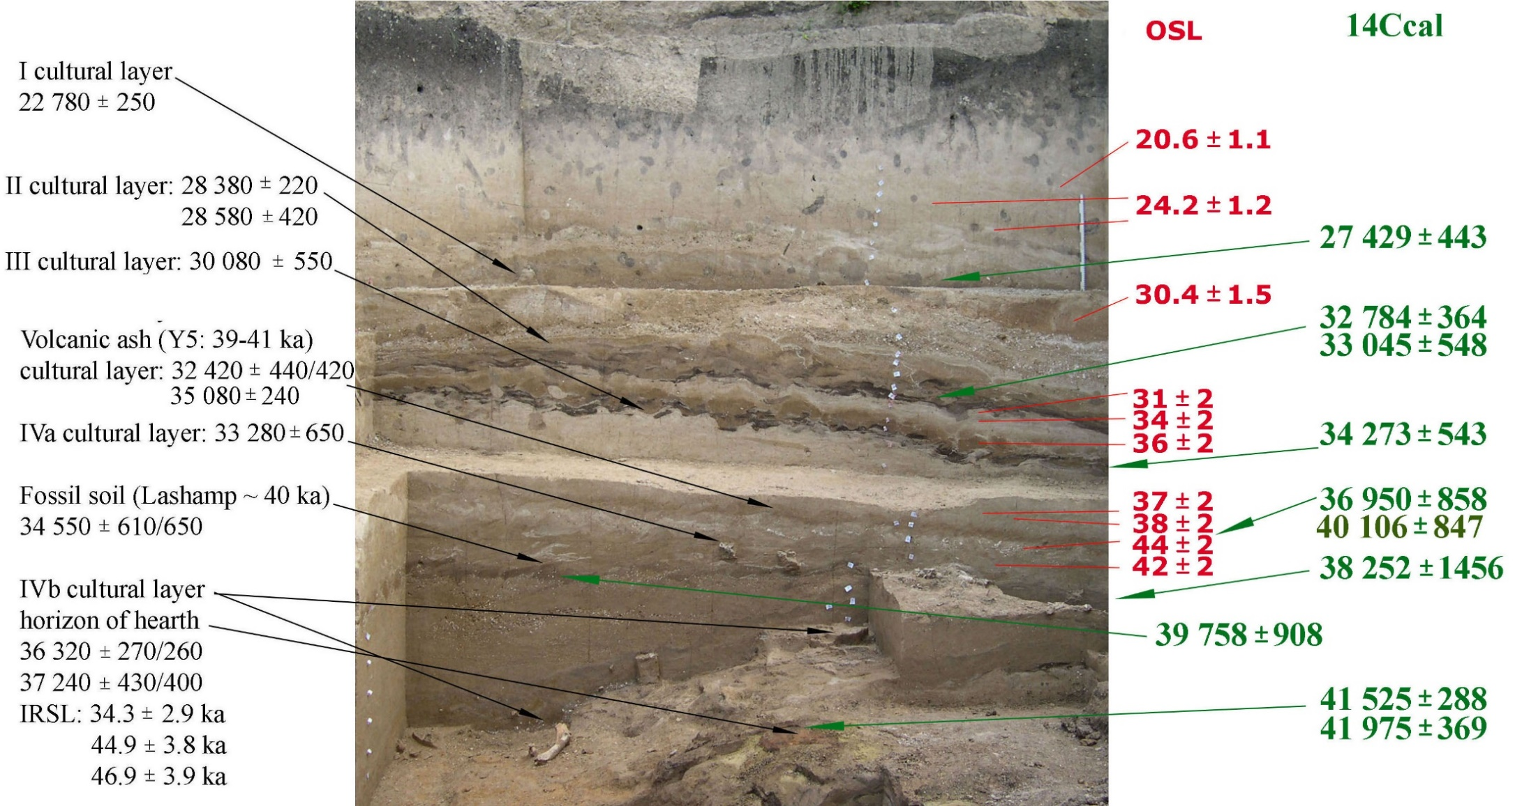
Kostenki 14. Eastern excavation. Section of the southern wall in 2004. Left - stratigraphic position of cultural layers and radiocarbon dates; on the right - calibrated radiocarbon dates and OSL dates

Slide 6
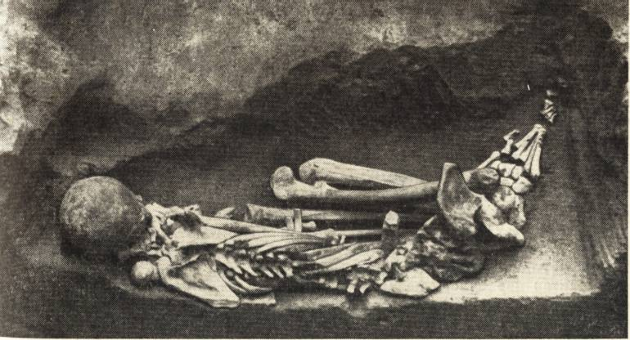
Kostenki 14. The grave of a man under the third cultural layer

Slide 7
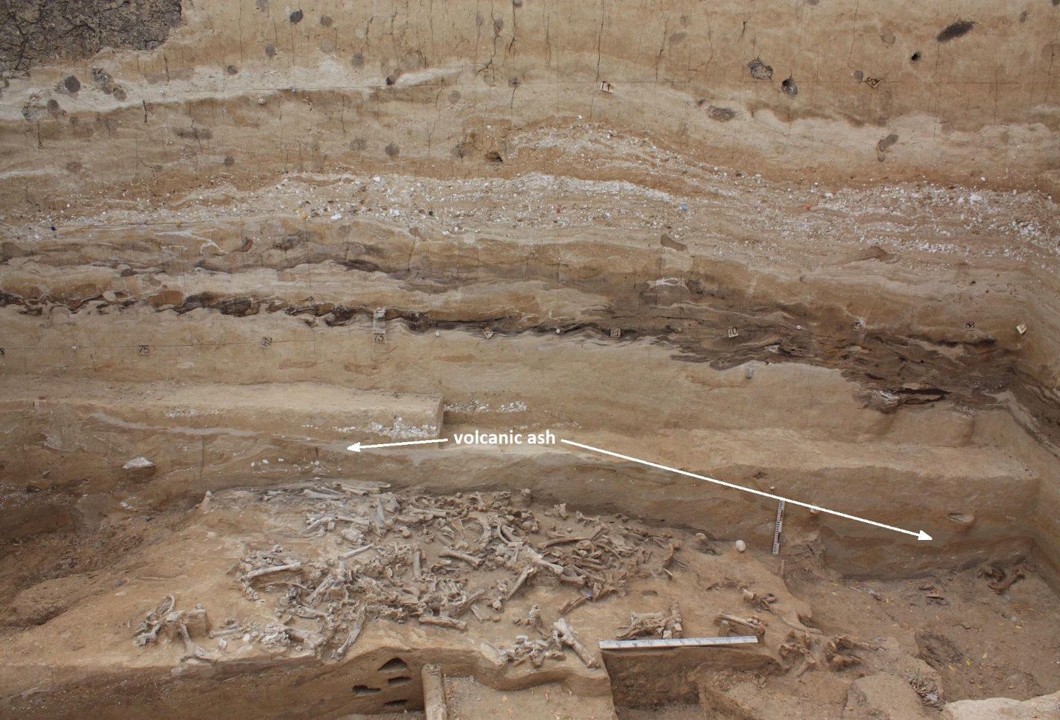
Kostenki 14. Cultural layer IVa in the excavation in 2009.
The arrows show a layer of volcanic ash

Slide 8
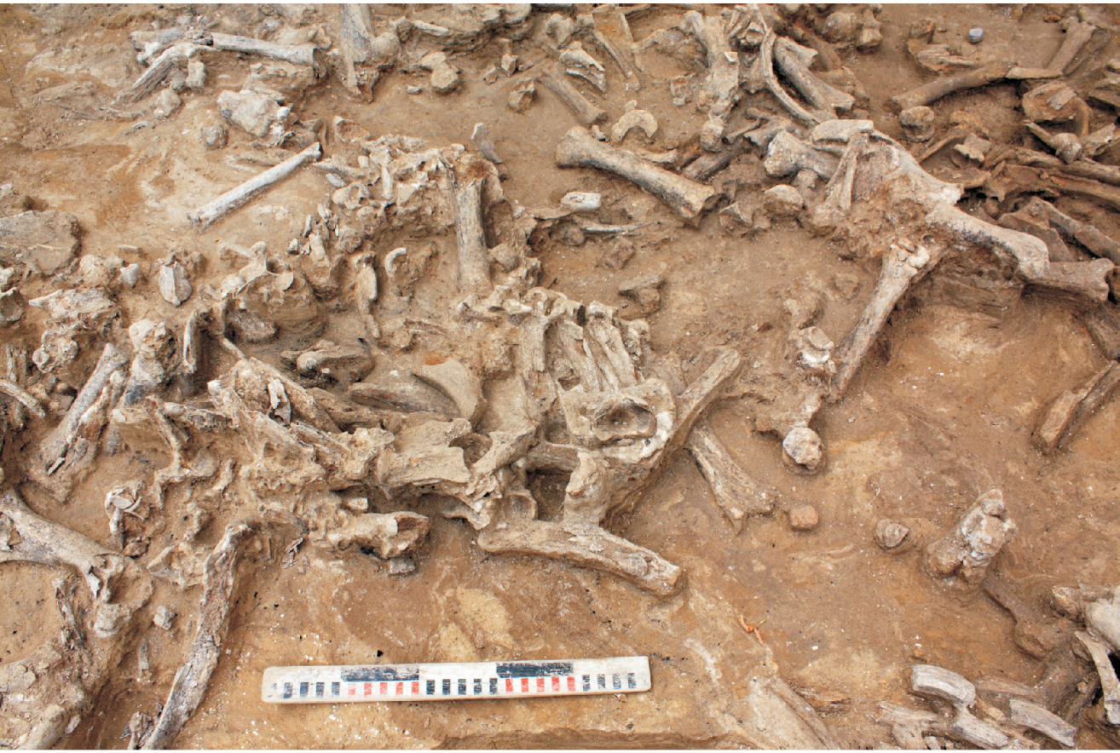
Osteological material of VIa layer of the upper Paleolithic site Kostenki 14. Squares U-72 and U-73. View from North. 2009.

Slide 9
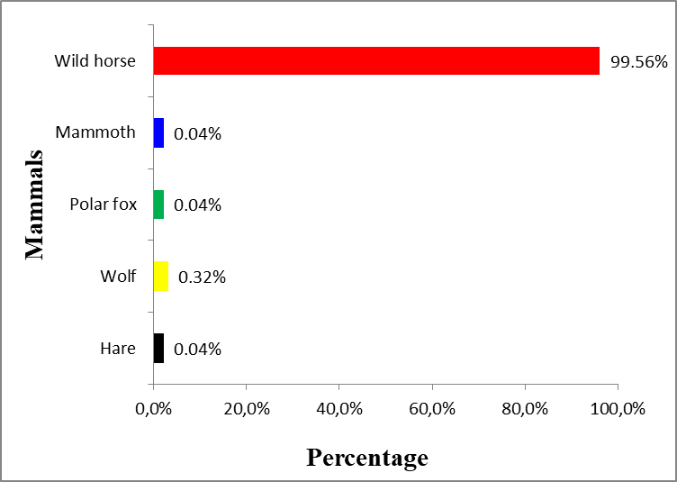
Percentage of different species on the upper Paleolithic site Kostenki 14 (layer IVa) (1998-2012)

Slide 10
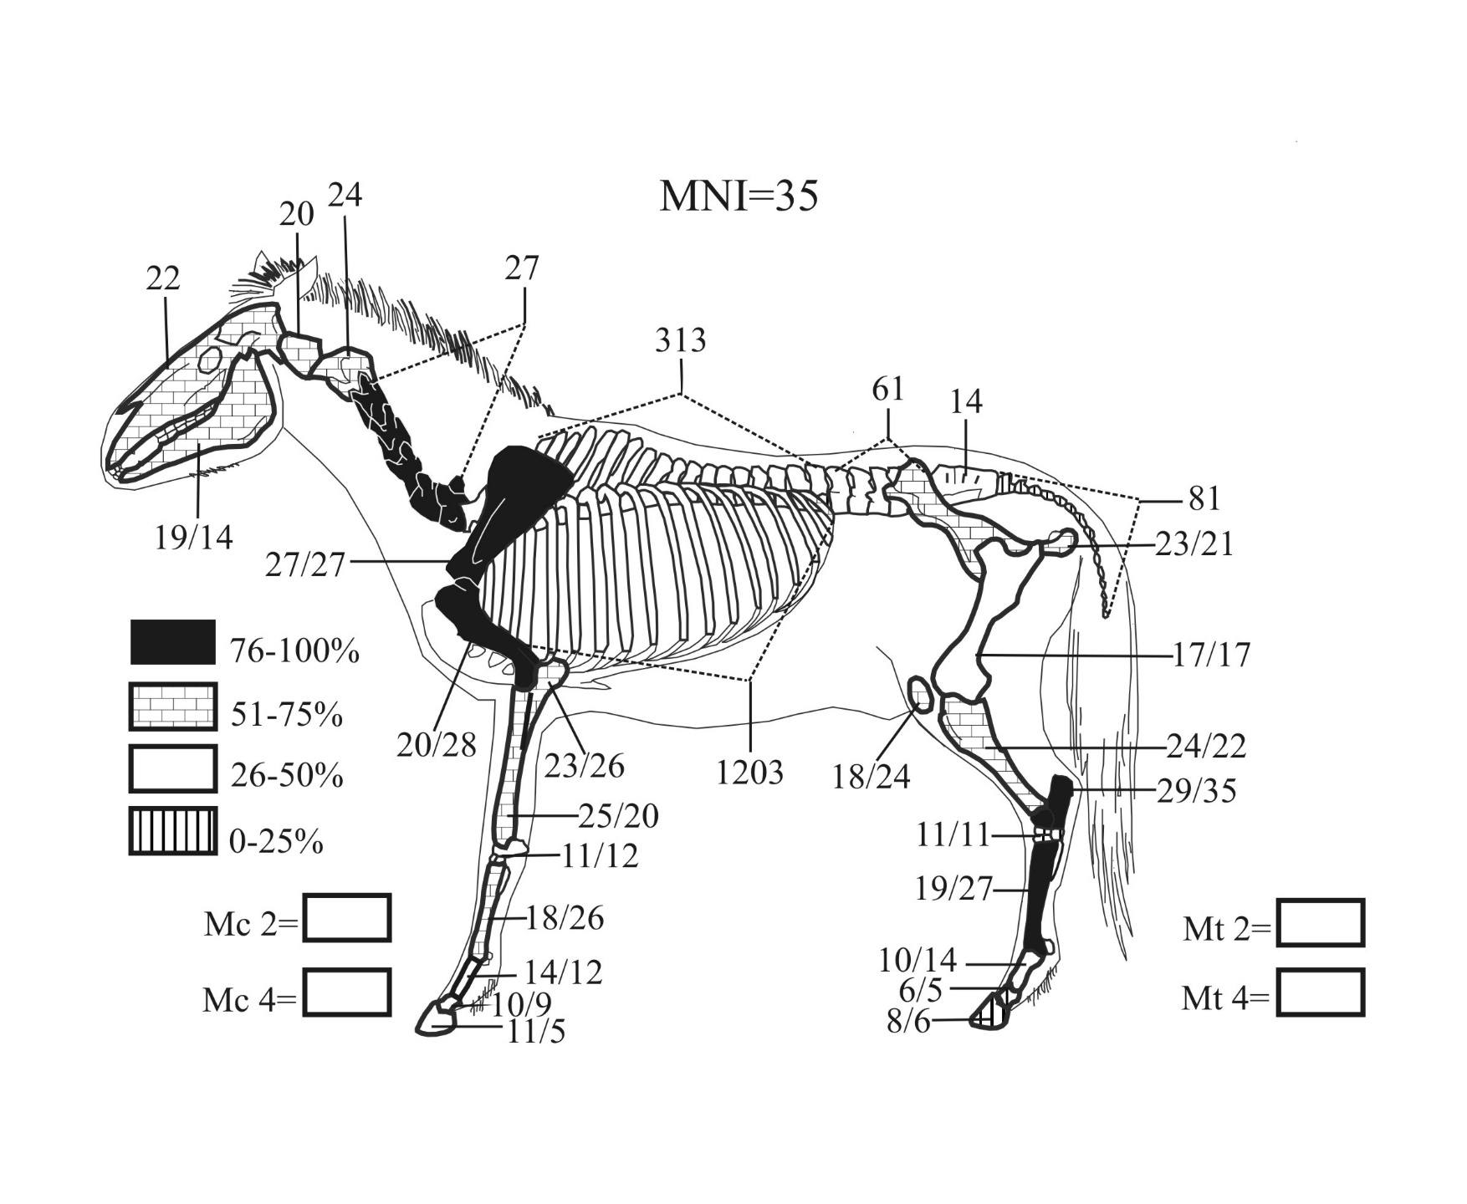
MNI - Minimal Number of Individuals
Percentage of different skeletal elements in the collection
(Burova, Petrova, 2011)

Slide 11
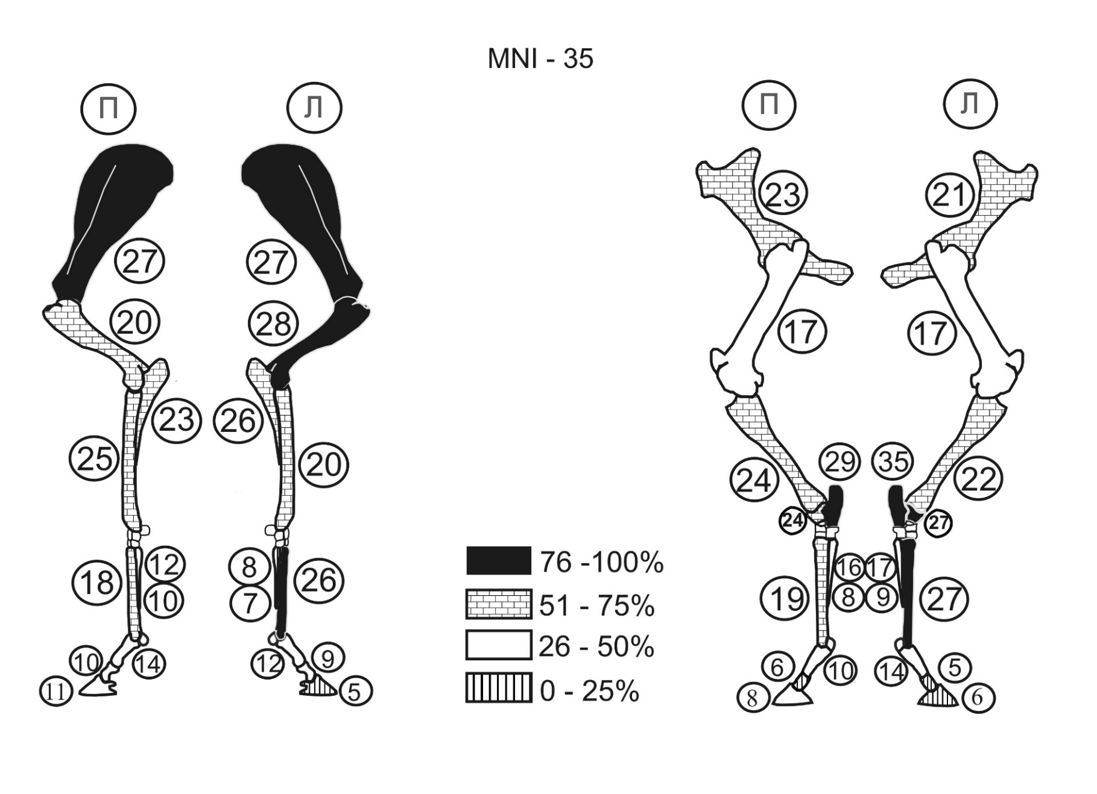
MNI - Minimal Number of Individuals. Percentage of different skeletal elements in the collection

Slide 12
Causes of formation of bone cluster in the layer VIa
The point of view of archaeologists
The layer is a kill-site where a herd of horses was killed and dressed by humans as a result of a one-time hunting.
The point of view of zooarchaeologists
Bone accumulation in the layer was formed as the result of death of several herds of horses in different seasons. Zooarchaeologists allow two scenarios: natural death and human hunt. In the first scenario humans could also take parts of dead horses or even finish dying animals.

Slide 13
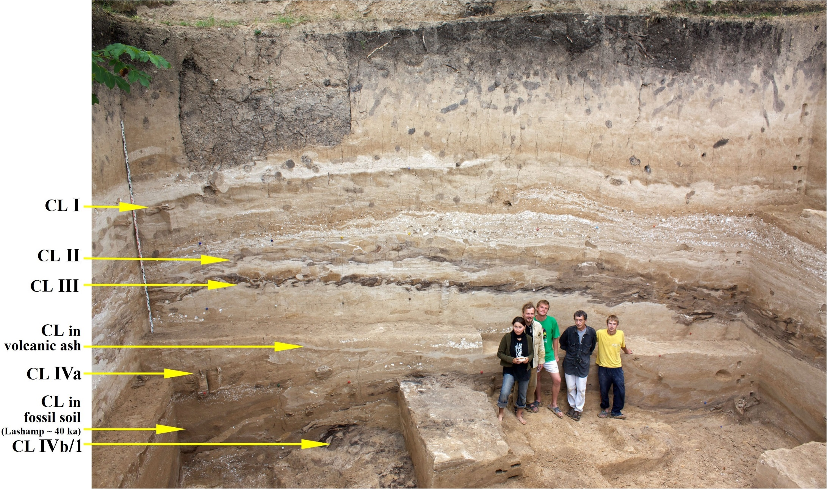
Kostenki 14 (Markina gora). South Wall section.
Location of cultural layers (CL). View from the North. 2009.

Slide 14
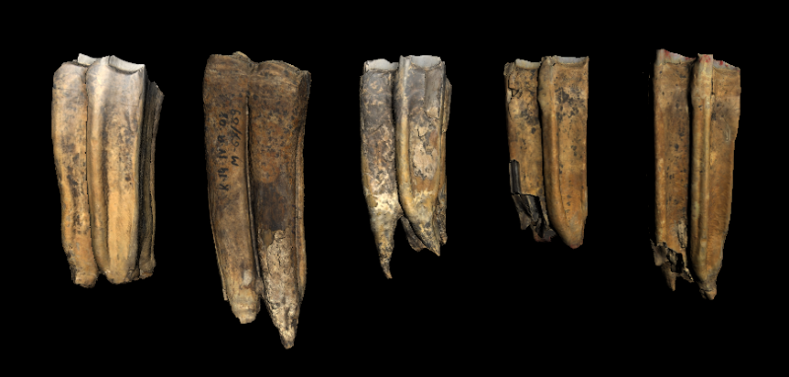
Teeth from the layer IVa of the Upper Paleolithic site Kostenki 14
36 cheek teeth belonging to 24 individuals were studied
82 thin sections and polished sections were made

Slide 15
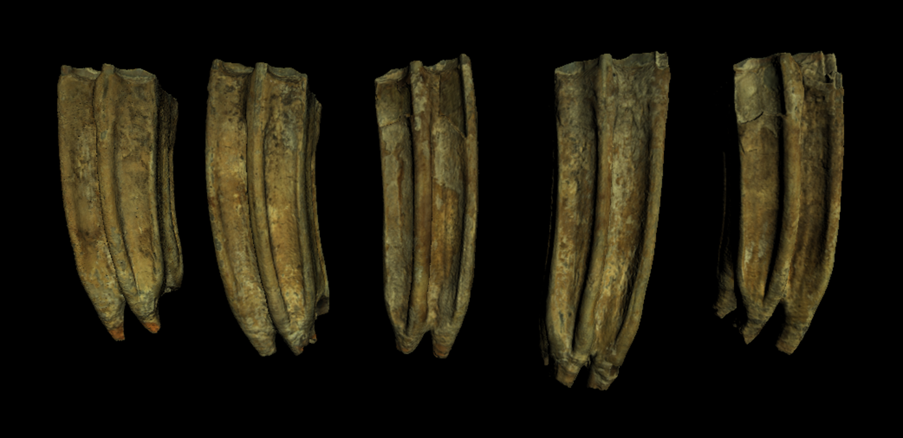
Teeth from the layer IVa of the Upper Paleolithic site Kostenki 14

Slide 16
Methods
3D scanning. All teeth were scanned in 3D with a 3D scanner before making thin sections and polished sections. 3D models can be seen in attached file.
Thin sections and polished sections preparation

Slide 17
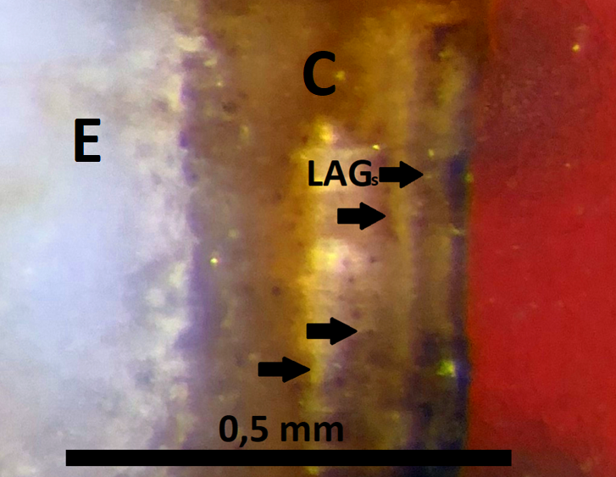
Growth layers in dental cementum of Equus ferus tooth (M1) from the layer IVa of the paleolithic site Kostenki-14 (Markina gora).
Sample #K-14-IVa-2008/K/L-69/56p.
LAG - line of arrested growth; C – cementum; E – enamel.

Slide 18
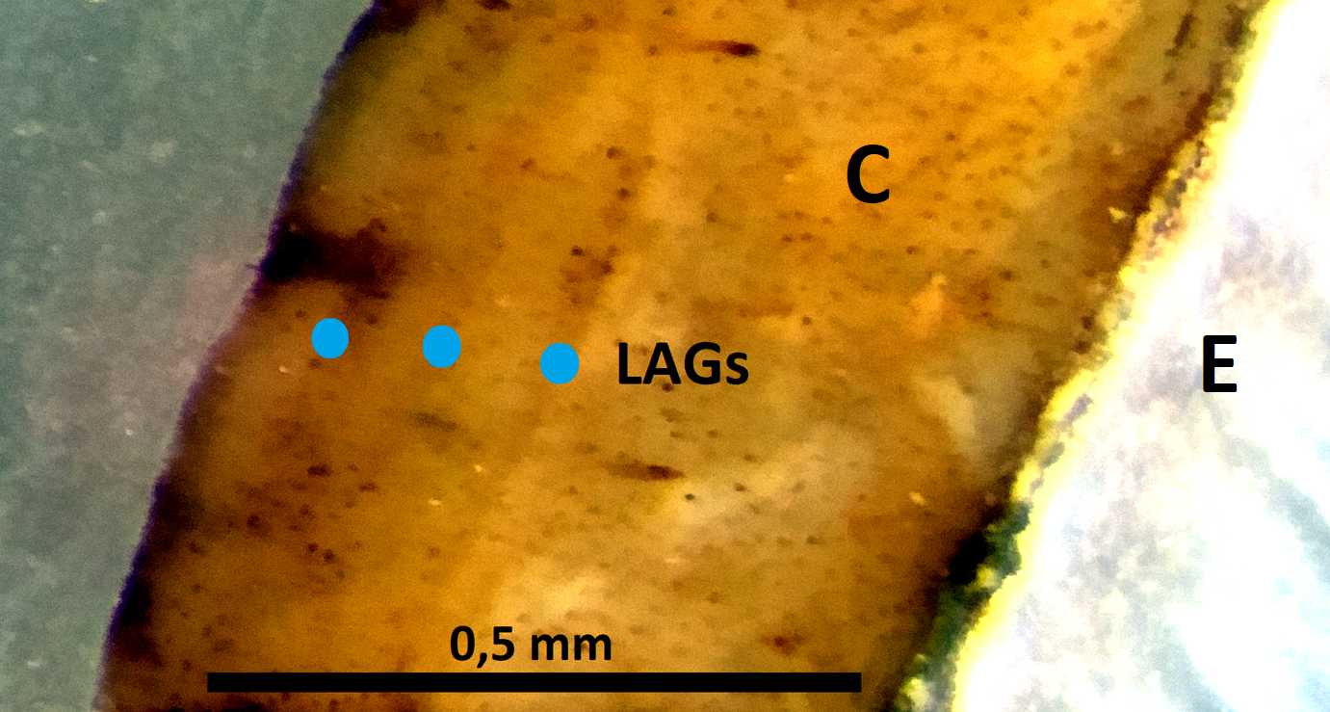
Growth layers in dental cementum of Equus ferus tooth (M1) from layer IVa of the paleolithic site Kostenki-14 (Markina gora).
Sample #K-14-IVa-1998/Π-69/20p.
LAG - line of arrested growth; C – cementum; E – enamel.

Slide 19
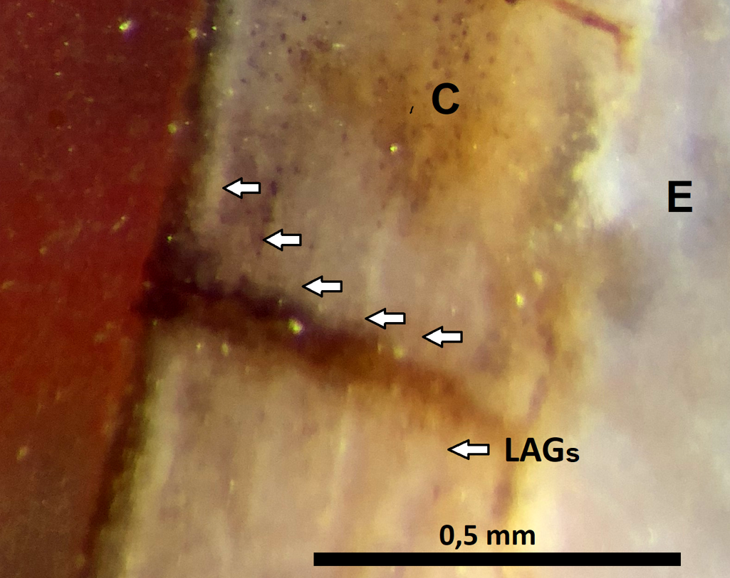
Growth layers in dental cementum of Equus ferus tooth (M1) from the layer IVa of the paleolithic site Kostenki-14 (Markina gora).
Sample #K-14-IVа-2008/M-68/55p.
LAG - line of arrested growth; C – cementum; E – enamel.

Slide 20
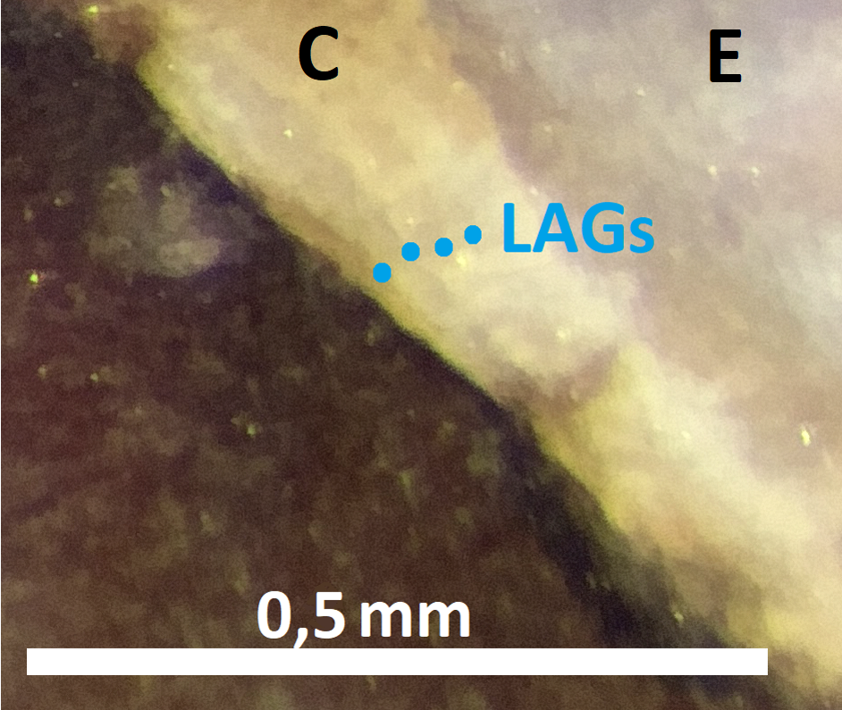
Growth layers in dental cementum of Equus ferus tooth (M1) from the layer IVa of the paleolithic site Kostenki-14 (Markina gora).
Sample #K-14-IVа-2008/M-68/69/46p.
LAG - line of arrested growth; C – cementum; E – enamel.

Slide 21
Results
A study of dental cement of Equus ferus from IVa cultural layer of the Upper Paleolithic site Kostenki-14 (Markina Gora) was done for the first time at this large-scale. Season of death was determined for 24 horses
Animals died in different seasons: spring-summer and autumn-winter
The numbers of horses died in different seasons differ by more than 2 times :
17 horses died in the spring-summer period
7 horses died in autumn-winter period

Slide 23
Conclusions
IVa cultural layer is a territory where horses died in different seasons
The numbers of horses died in different seasons differ by more than 2 times

Slide 24
References
Beasley M.J., Brown W.A.B. and Legge A.J. (1992) Incremental Banding in Dental Cementum: Methods of Preparation for Teeth from Archaeological Sites and for Modern Comparative Specimens // International Journal of Osteoarchaeology, Vol. 2, 37-50.
Burke A. (1992) Prey Movements and Settlement Patterns during the Upper Palaeolithic in Southwestern France. PhD Dissertation. New York, 306.
Burke A. and Castanet J. (1995) Histological Observations of Cementum Growth in Horse Teeth and their Application to Archaeology // Journal of Archaeological Science, 22, 479–493
Burova N.D. and Petrova E.A. (2011) Archeozoology of the IVa cultural layer of the Upper Paleolithic site Kostenki 14 // Cultural-historical processes in the Paleolithic of Eurasia: human settlement, cultural genesis, material culture and natural environment. Proceedings of the III (XIX) All-Russian Archaeological Congress. Vol. 1. St. Petersburg-Moscow-Veliky Novgorod (In Russian), 31-32.
Greenfield H.J., Moore N.C. and Steppan K. (2015) Estimating the Age- and Season-of-Death for Wild Equids: a Comparison of Techniques Utilising a Sample from the Late Neolithic Site of Bad Buchau-Dullenried, Germany // Open Quaternary, 1: 3, 1-28
Klevezal G.A. (1988). Recording Structures of Mammals in Zoological Investigations. Moscow: Nuaka (In Russian), 288.
Lieberman D.E. (1994). The Biological Basis for Seasonal Increments in Dental Cementum and Their Application to Archaeological Research // Journal of Archaeological Sience 21, 525 – 539.
Lieberman D.E. and Meadow R.H. (1992) The Biology of Cementum Increments (with an archaeological application) // Mammal Review, Vol. 22, Issue 2, 57-77.
Praslov, N. D. and Rogachev, A. N. (eds.) (1982). Palaeolithic of the Kostenki–Borshchevo area on the river Don. 1879–1979. Results of field investigations]. Leningrad: Nuaka (In Russian). 288.
Sinitsyn A. (2009) Proceedings of Kostenki archaeological expedition IHMC RAS, 40.
Sinitsyn A. (2015a) Kostenki 14 (Markina Gora) - A Supporting Column of Cultural and Geological Deposits of the Eastern Europe Paleolithic for a Period of 27–42 thousand years (GS-11 – GI-3) // Ancient Cultures of Eastern Europe: Reference Sites and Supporting Complexes in the Context of Modern ArchaeologicalRresearch. Zamyatny collection. Issue 4. SPb.: MAE RAS (In Russian), 40-59.
Sinitsyn A. (2015b) Perspectives on the Palaeolitic of Eurasia: Kostenki and related sites // Human Origin Sites and the World Heritage Convention in Eurasia. UNESCO Heads 4, Vol. 1, 163 – 189.
Spiess A.E. (1976). Determining season of Death of Archaeological Fauna by Analysis of Teeth // Journal of the Arctic Institute of North America, 29, 53–55.

Slide 25
Acknowledgments
We expresses our gratitude and appreciation to Dr. Ariane Burke and Dr. Galina Clevezal for their help.
Collections study facilitated by:
The Institute of the History of Material Culture of Russia Academy of Science
Zoological Institute of Russia Academy of Science

Slide 26
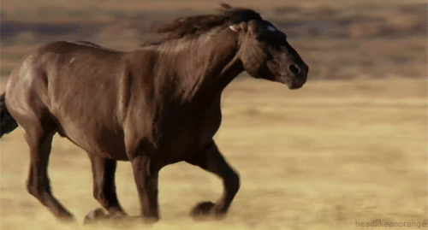
Thank you!

